Slide 1
Readiness for School
Little Acorns (Colleton) Pre School

Slide 2
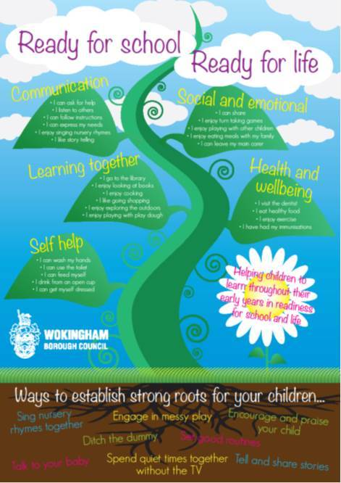
Wokingham Borough Website
http://wsh.wokingham.gov.uk/early-years-childcare-and-play/ready-for-school/ready-for-school-life/

Slide 3
Communication – I can ask for help, I listen to others, I can follow instructions, I can express my needs, I enjoy singing nursery rhymes, I like story telling.
What we do at pre-school:
Encourage children to talk to staff and each other.
Show and Tell.
Arts and crafts.
Story, singing and music activities.
Modelling how to ask for help, listen to others and express needs.
Role play.
What you could do at home:
Read lots of stories.
Sing nursery rhymes and songs.
Talk to them about what you are doing all the time.
Play ‘follow instruction’ games e.g. Simon Says

Slide 4
Social and Emotional – I can share, I enjoy turn taking games, I enjoy playing with other children, I enjoy eating meals with my family, I can leave my main carer.
What we do at pre-school:
Enhancement boxes.
Activities with resources designed to encourage sharing or waiting their turn.
Rolling snack time.
Wobbly tray day ☺
What you could do at home:
Games such as snakes and ladders.
Sharing food, toys, books etc with you or a sibling.
If possible try to eat together once a week.
Treat yourself to a night out – babysitter!

Slide 5
Learning Together – I go to the library, I enjoy looking at books, I enjoy cooking, I like going shopping, I enjoy exploring the outdoors, I enjoy playing with play dough.
What we do at pre-school:
Trips in the summer term.
Cooking and play dough activities.
Role play corners (shop etc)
Story boxes/bags
What you could do at home:
Trips to the park.
Making biscuits or cakes.
Reading your favourite childhood story.
Visits to the library.

Slide 6
Health and Wellbeing – I visit the dentist, I eat healthy food, I enjoy exercise, I have had my immunisations.
What we do at pre-school:
Provide a healthy snack.
Sports Day.
Teach the children how to keep calm.
Talk to the children about the importance of exercise and healthy eating.
What you could do at home:
Immunisations and dentist visits up to date?
Provide healthy food options.
Encourage outdoor activity.

Slide 7
Self Help – I can wash my hands, I can use the toilet, I can feed myself, I drink from an open cup, I can get myself dressed.
What we do at pre-school:
Routines e.g. wash hands before snack.
Encouraging independence from early stage e.g. toilet by self, wash hands, drink and feed self, put on own coats and shoes.
Encourage children to begin to do their own zips on coats.
What you could do at home:
Allow children to choose their own clothes to wear.
Let them dress themselves.
Teach children to wipe correctly.
Teach children to wash hands correctly.
Teach them how to blow their noses and always wash hands.
Encourage them to put on their own shoes and coat.

Slide 8
Phonics
Phonics in pre-school is about preparing children to learn to read and instilling the love of books.
At Little Acorns, we believe that encouraging children to listen well, enjoy nursery rhyme and singing activities and understanding spoken language is the best base to build upon.
We follow Letters and Sounds Phase One and a singing phonics programme.

Slide 9
Phonics
Do we teach the sounds, Jolly Phonics actions, letter names etc?
https://www.youtube.com/watch?v=IwJx1NSineE
Oral blending and segmenting. Easier for children to blend. Start with initial sound followed by the rest of the word (onset and rime) e.g. c-oat or c-at
When children comfortable with this then can move on to c/oa/t or c/a/t.
Segmenting will generally come later (when in school) although we will introduce the concept.

Slide 10
Writing
Early writing is called Mark Making.
Activities that develop fine motor skills and arm/shoulder muscles
Reading books/watching iPads on their tummies.
Colouring, drawing, cutting, sticking,
Playdough
Gloop
Hamma Beads
Stress balls
Little Lego
Don’t worry about pencil grip. Show them correctly once and if they go back to a fist grab just leave them as this means they are not quite ready.
Don’t worry about writing their names. It is far more important that they can recognise their own and not just the first letter.
Notes:
If they want to start writing obviously don’t stop them but we do not sit them down and teach them to write. It is far more important that we concentrate on strengthening muscles than jumping ahead to writing.

Slide 11
Mathematics
Maths in pre-school is very practical and hands on.
Number
Shape, space and measure

Slide 12
Mathematics
Continue to count….everything!
Spot numbers and shapes in the environment.
If they spot a number e.g. 6 can they show you 6 fingers (understanding that a number – number of any object).
Introduce money, maybe pocket money or allow them to play with money to become familiar with the coins.
Discuss time with the children in relation to routines and what happens when.

Slide 13
Summary To prepare your child for school they should be able to -
Understand the concept of sharing and turn taking.
Play with other children.
Ask for help.
Listen and follow instructions.
Dress themselves - including coat, socks and shoes.
Blow their noses, put tissues in the bin then wash hands.
Go to the toilet and wipe independently.
Enjoy listening to stories and rhymes.

